Slide 1

Apol-lost Synoptic Project – Pre Production phase
By operation discovery (Aiden, Cade, Eduard and Sebastian.)

Slide 2
iNTRODUCTION
As our project wasn’t green lit, we’ve worked hard on our VFX project to show you our pre-production works and what everyone has been working on!
With that being said, let’s move onto the content.

Slide 3
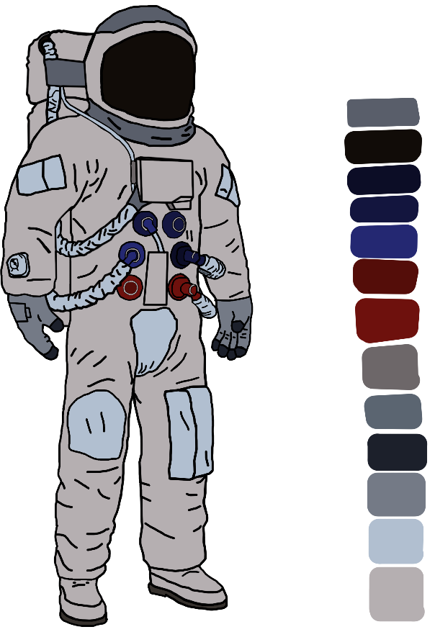
Concept art (Cade and Aiden)

Slide 4
Film test

Slide 5
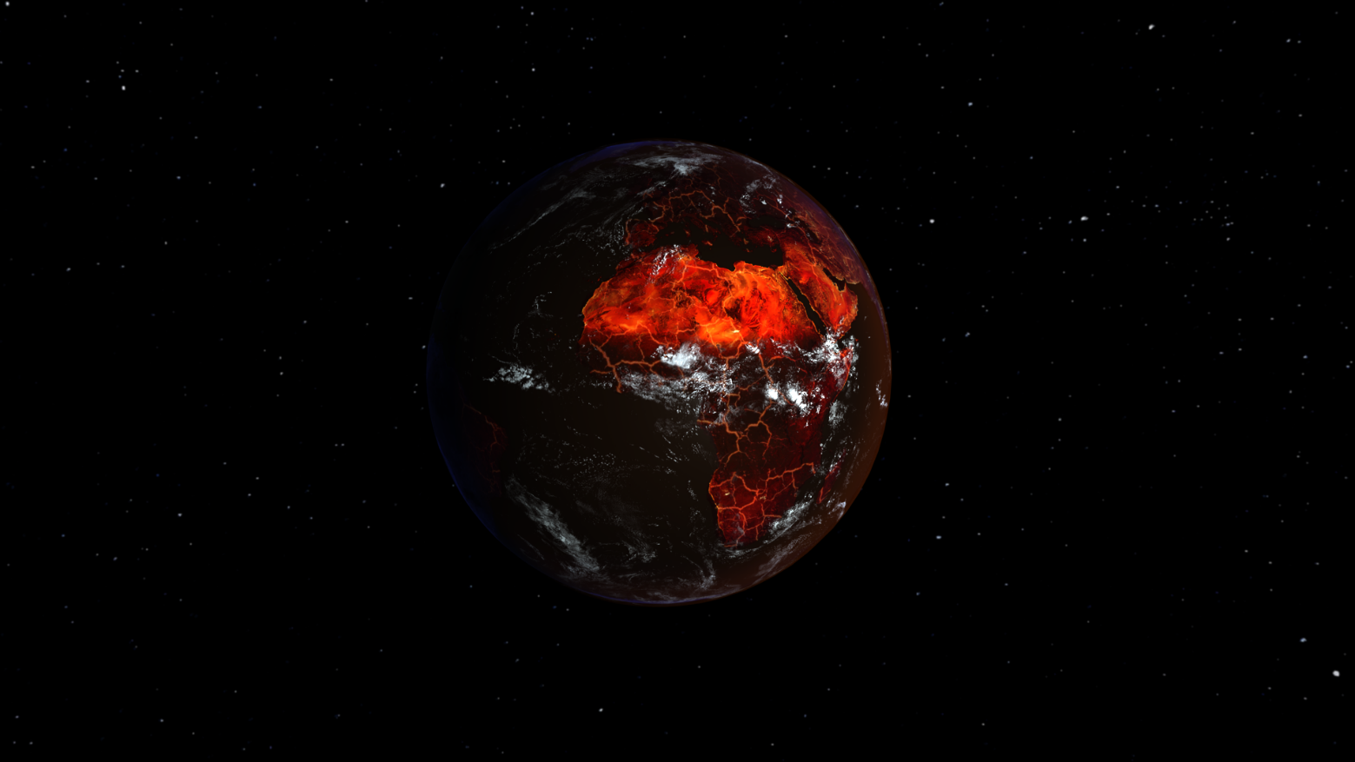
Earth (EDUARD)

Slide 6
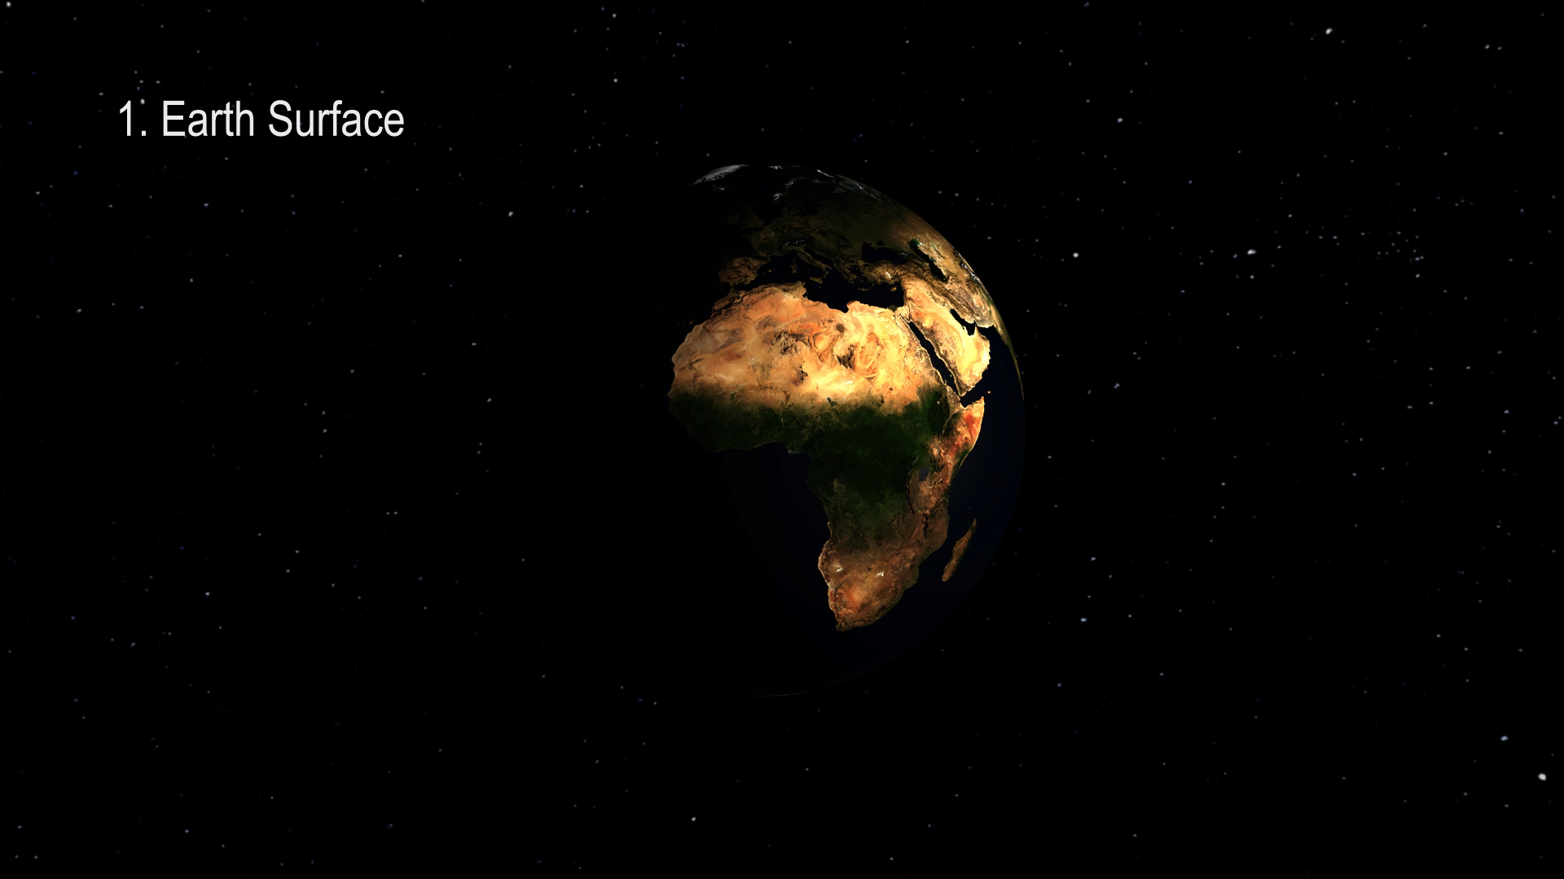
VFX Breakdown video of Earth 3D model

Slide 7
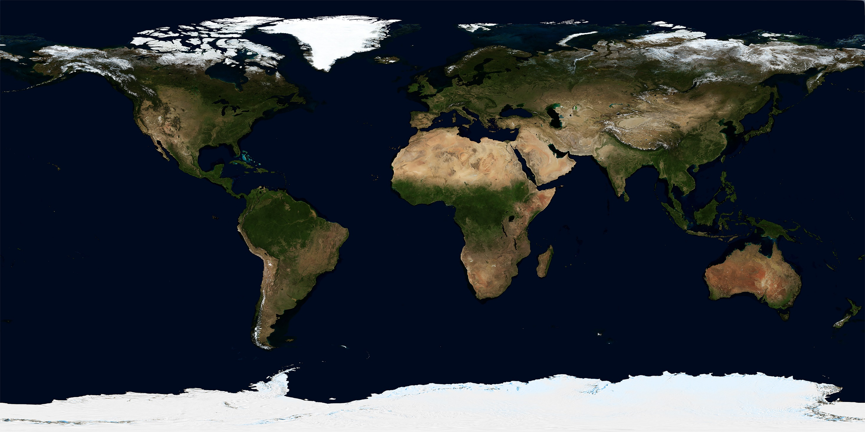
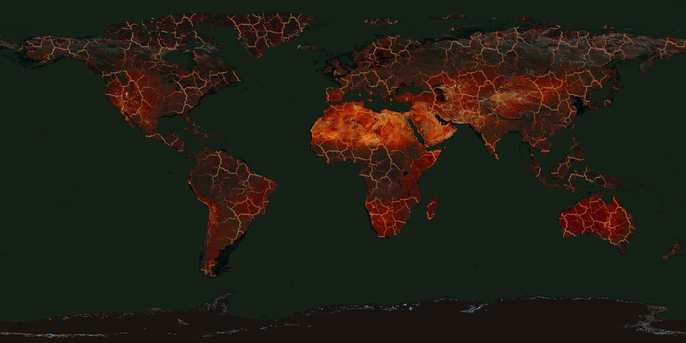
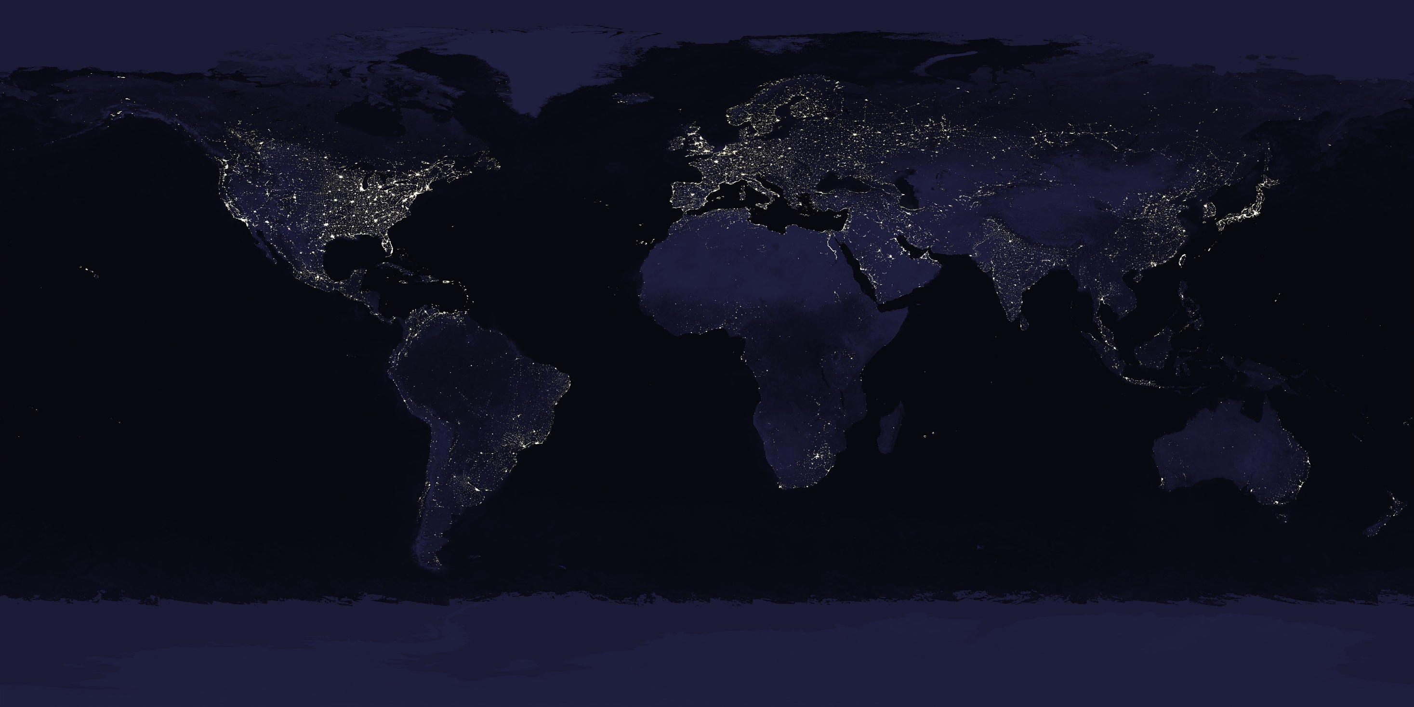
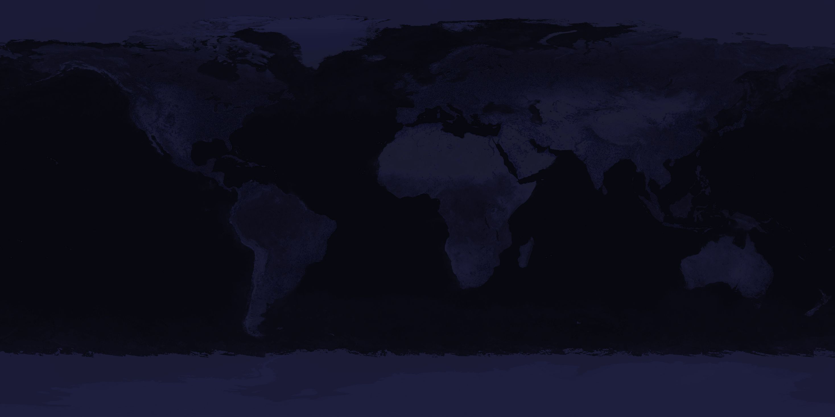
Textures

Slide 8
Animatic (Aiden)

Slide 9
prop making assets (Sebastian)

Slide 10
What we’ve improved on
With all the feedback we’ve received in our project RAG pitch, our team has tried their best.

Slide 11
Minimum goals for production

Slide 12
Strecth goals for production

